Slide 1
Some Nested NER papers in 2022
武乐飞
2022.05.13

Slide 2
Some Nested NER papers in 2022
录用
Parallel Instance Query Network for Named Entity Recognition, ACL-2022
Nested Named Entity Recognition as Latent Lexicalized Constituency Parsing, ACL-2022
Bottom-Up Constituency Parsing and Nested Named Entity Recognition with Pointer Networks, ACL-2022
Propose-and-Refine: A Two-Stage Set Prediction Network for Nested Named Entity Recognition, IJCAI-2022
Fusing Heterogeneous Factors with Triaffine Mechanism for Nested Named Entity Recognition, ACL-2022-F
录用无PDF
De-Bias for Generative Extraction in Unified NER Task, ACL-2022
Nested Named Entity Recognition with Span-level Graphs , ACL-2022
未录用
Local Hypergraph-based Nested Named Entity Recognition as Query-based Sequence Labeling, IJCAI-Reject

Slide 3
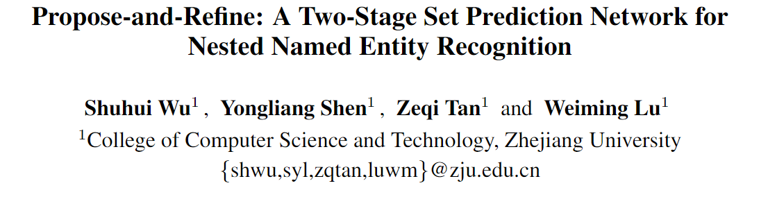

Propose-and-Refine: A Two-Stage Set Prediction Network for Nested Named Entity Recognition
文章介绍
浙大DCD实验室，鲁伟明等

Slide 4
Propose-and-Refine: A Two-Stage Set Prediction Network for Nested Named Entity Recognition
研究动机
当前span based方法没有考虑span 间交互；
且无法有效识别长实体(由于长度设定限制).
提出一种两阶段方法，第一阶段通过span方法获得粗糙结果；第二阶段考虑span间交互，并融入多尺度上下文，进一步精调实体边界和类型.

Slide 5
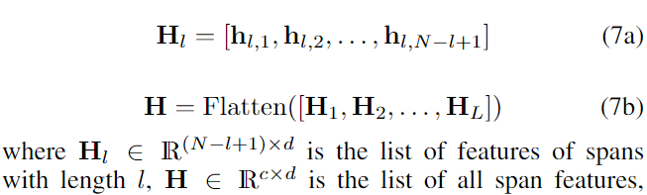
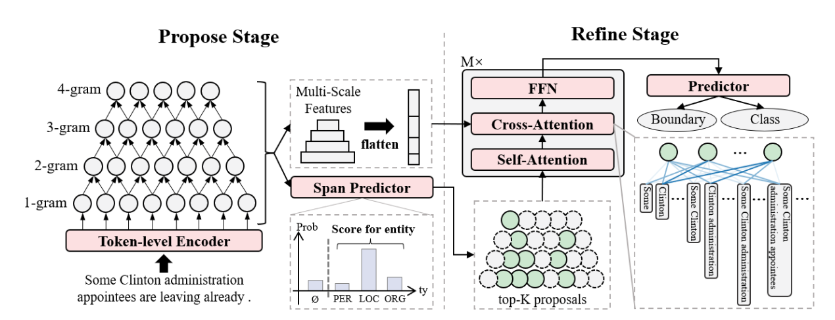
Propose-and-Refine: A Two-Stage Set Prediction Network for Nested Named Entity Recognition
模型方法
多尺度特征：不同长度的span分别拼接展平
两阶段方法：第一阶段通过span方法获得粗糙结果；第二阶段考虑span间交互，并融入多尺度上下文，进一步精调实体边界和类型.

Slide 6
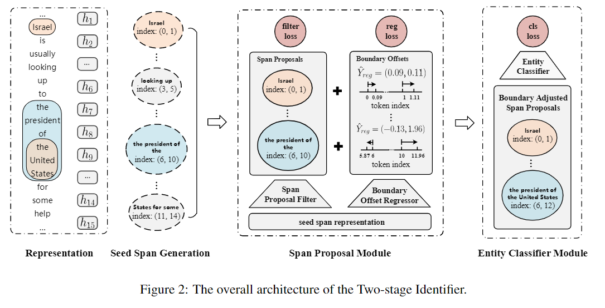
Propose-and-Refine: A Two-Stage Set Prediction Network for Nested Named Entity Recognition
Locate and Label: A Two-stage Identifier for Nested Named Entity Recognition，ACL2021
浙大DCD实验室，鲁伟明等. 2021ACL的工作，先粗略筛选，在精调边界和类型。

Slide 7
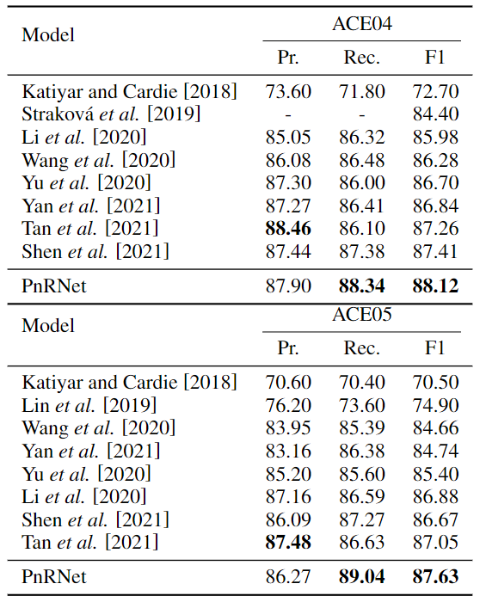
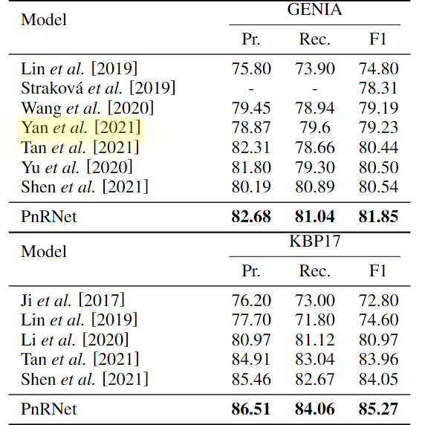
Propose-and-Refine: A Two-Stage Set Prediction Network for Nested Named Entity Recognition
主要实验

Slide 8
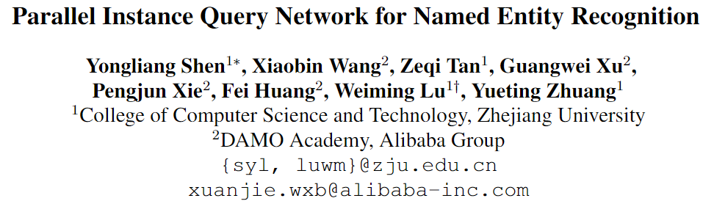
Parallel Instance Query Network for Named Entity Recognition
文章介绍
浙大DCD实验室，鲁伟明等
阿里巴巴，黄非

Slide 9
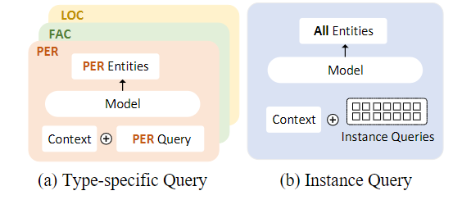
Parallel Instance Query Network for Named Entity Recognition
研究动机
一些工作将嵌套NER建模为阅读理解任务¹，这类方法存在以下不足：
首先，特定类型的查询每次推理只能提取一种类型的实体，这是低效的；
其次，对不同类型实体的提取是孤立的，忽略了它们之间的依赖关系；
第三，查询构建依赖于外部知识，难以应用于具有数百种实体类型的现实场景。
本文提出并行实例查询网络（PIQN）, 通过全局和可学习的实例查询，以并行方式从句子中提取实体，并行查询所有实体，不依赖外部知识构建。
1: A Unified MRC Framework for Named Entity Recognition，ACL-2020

Slide 10
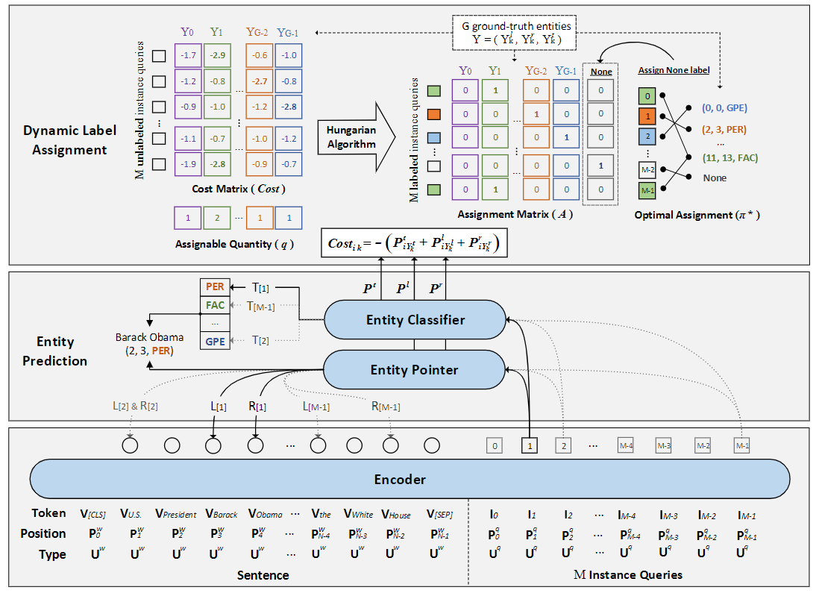


Parallel Instance Query Network for Named Entity Recognition
模型方法
特点:
并行查询，一次识别多个实体
不需要外部知识，自动学习query
one-to-many 线性分配标签
任务定义:
：句子和标签
左边界
右边界
类型
M个查询向量，大于类别数，一个向量
抽取一种类型，可一对多。

Slide 11
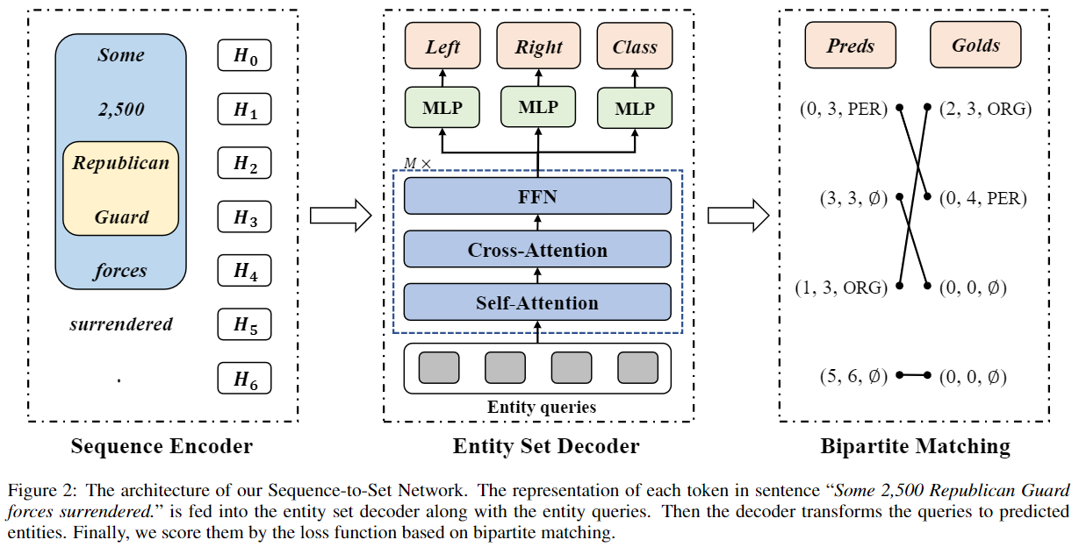
Parallel Instance Query Network for Named Entity Recognition
模型方法
A Sequence-to-Set Network for Nested Named Entity Recognition, IJCAI 2021, 浙大DCD，鲁伟明

Slide 12
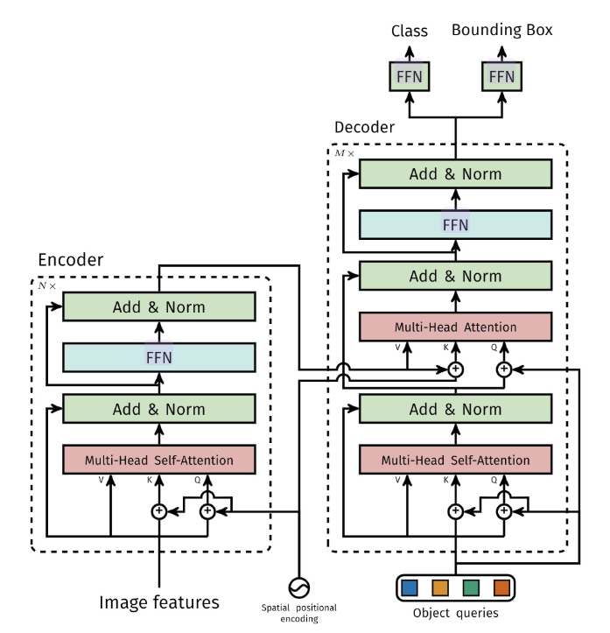
Parallel Instance Query Network for Named Entity Recognition
模型方法
A Sequence-to-Set Network for Nested Named Entity Recognition, IJCAI 2021, 浙大DCD，鲁伟明
目标检测：DETR

Slide 13
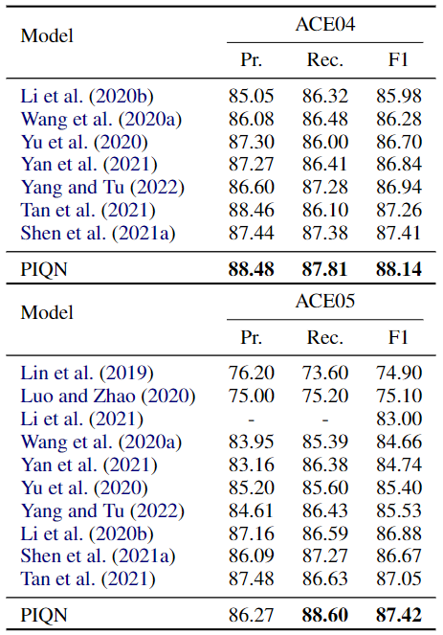
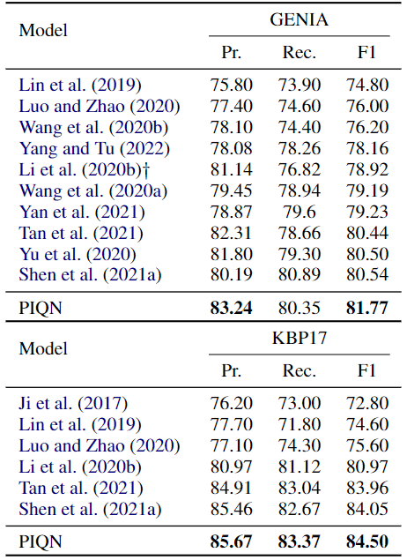
Parallel Instance Query Network for Named Entity Recognition
主要实验
Nested NER

Slide 14
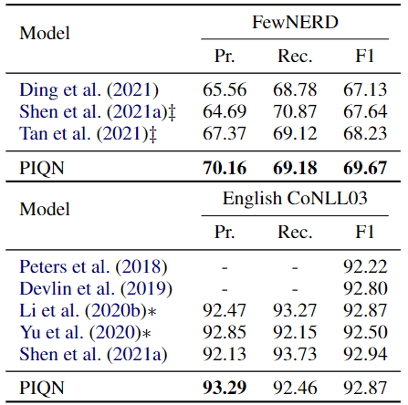
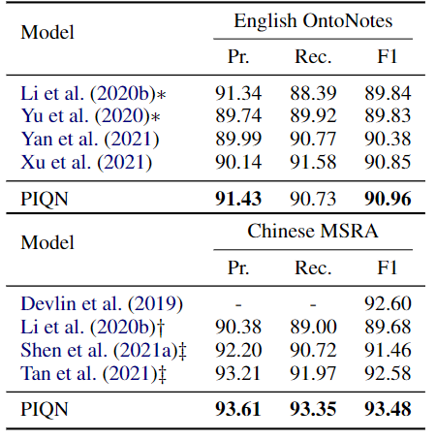
Parallel Instance Query Network for Named Entity Recognition
主要实验
Flat NER

Slide 15
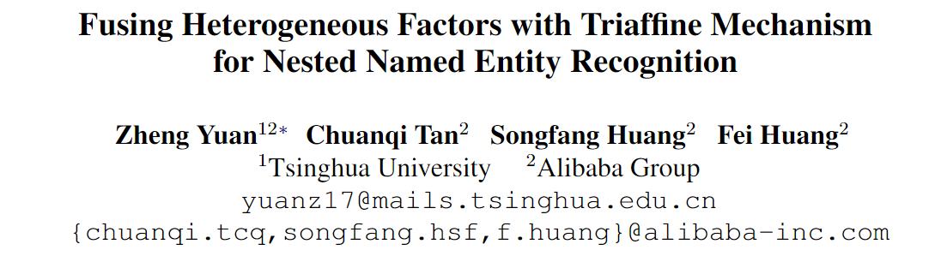
Fusing Heterogeneous Factors with Triaffine Mechanism for Nested Named Entity Recognition
文章介绍
阿里巴巴，黄非

Slide 16
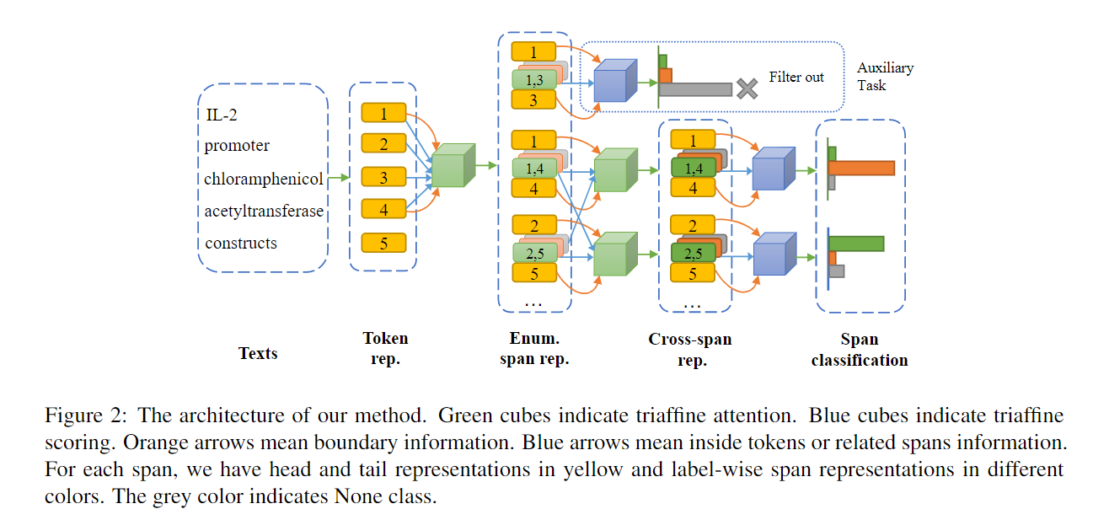
Fusing Heterogeneous Factors with Triaffine Mechanism for Nested Named Entity Recognition
模型方法

Slide 17
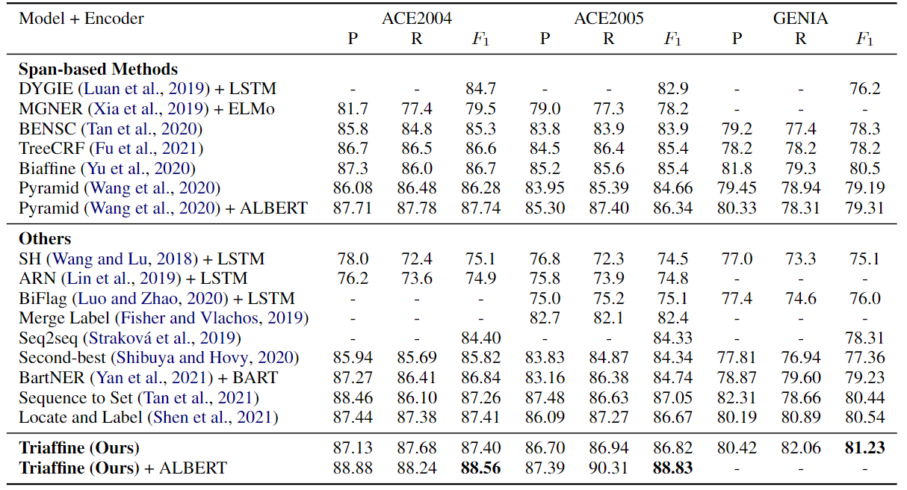
Fusing Heterogeneous Factors with Triaffine Mechanism for Nested Named Entity Recognition
主要实验

Slide 18
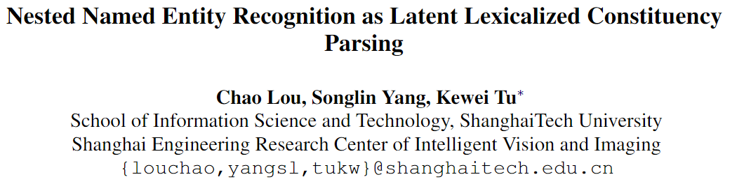

Nested Named Entity Recognition as Latent Lexicalized Constituency Parsing
文章介绍
上科大 屠可伟

Slide 19
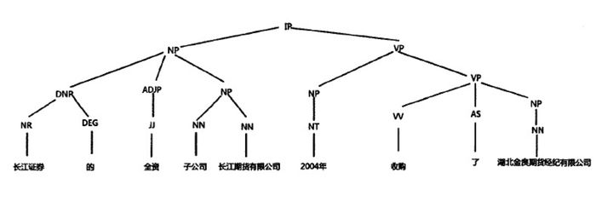
Nested Named Entity Recognition as Latent Lexicalized Constituency Parsing
研究动机
constituency parser：成分句法分析
针对Fu et al. (2020)和Anchor-Region Networ进行改进, 该方法没有考虑entity heads(中心词)，这对实体识别很重要.
本文利用Lexicalized Constituency Parsing建模嵌套实体；
还采用了：
1. a two-stage strategy：两阶段策略
2. a head regularization loss and ：头正则损失
3. a head-aware labeling loss ：头部感知标签损失
Fu et al. (2020) : Nested Named Entity Recognition with Partially-Observed TreeCRFs, AAAI-2021, Edinburgh&阿里
Sequence-to-nuggets: Nested entity mention detection via anchor-region networks , ACL 2019，张载讲过

Slide 20
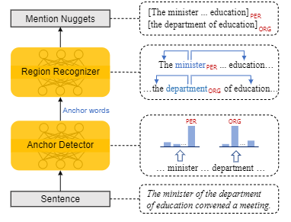
Nested Named Entity Recognition as Latent Lexicalized Constituency Parsing
研究动机
constituency parser：成分句法分析
针对Fu et al. (2020)和Anchor-Region Networ进行改进, 该方法没有考虑entity heads，这对实体识别很重要.
本文利用Lexicalized Constituency Parsing建模嵌套实体；
还采用了：
1. a two-stage strategy：两阶段策略
2. a head regularization loss and ：头正则损失
3. a head-aware labeling loss ：头部感知标签损失
Fu et al. (2020) : Nested Named Entity Recognition with Partially-Observed TreeCRFs, AAAI-2021, Edinburgh&阿里
Sequence-to-nuggets: Nested entity mention detection via anchor-region networks , ACL 2019，张载讲过

Slide 21
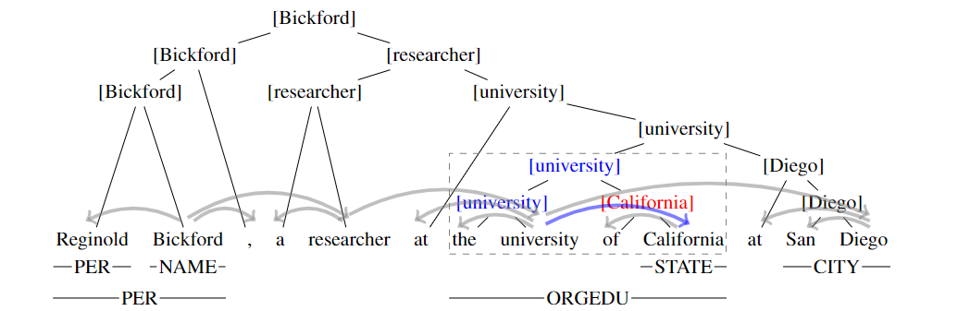
Nested Named Entity Recognition as Latent Lexicalized Constituency Parsing
模型方法
枝干
叶子节点

Slide 22
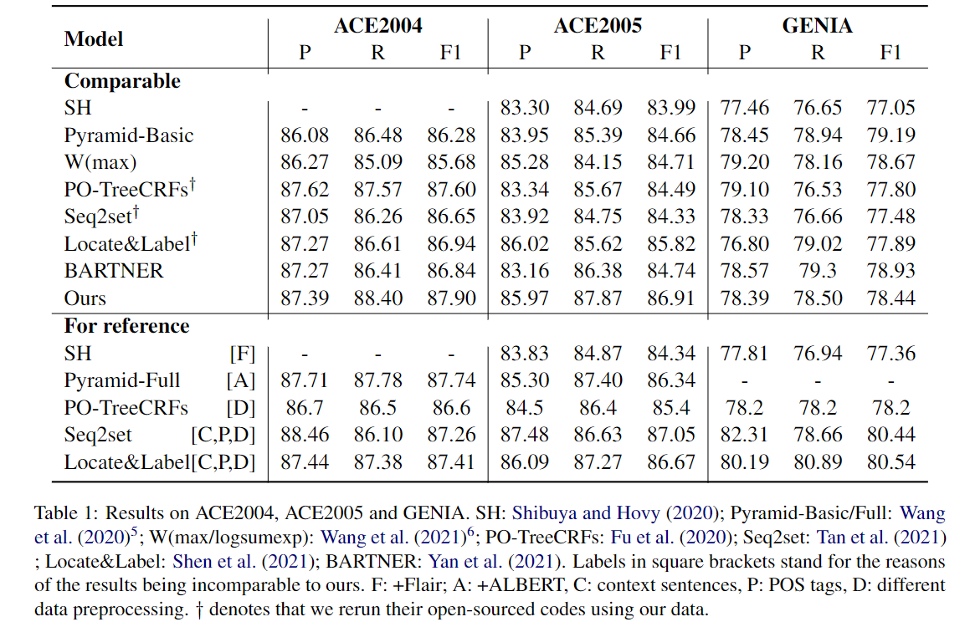
Nested Named Entity Recognition as Latent Lexicalized Constituency Parsing
主要实验
重跑实验

Slide 23
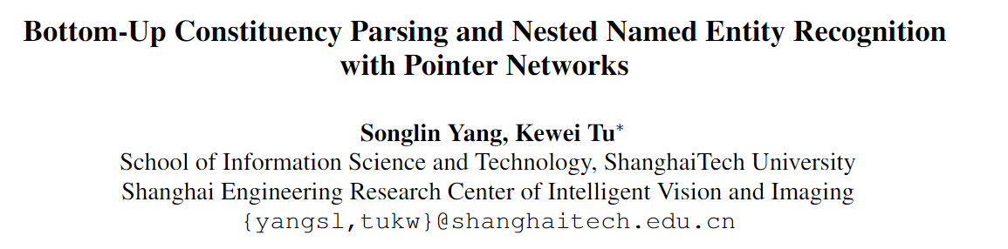
Bottom-Up Constituency Parsing and Nested Named Entity Recognition with Pointer Networks
文章介绍
上科大 屠可伟

Slide 24
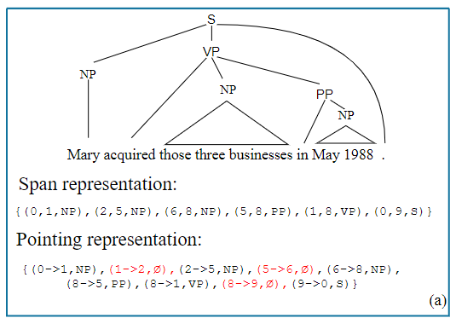
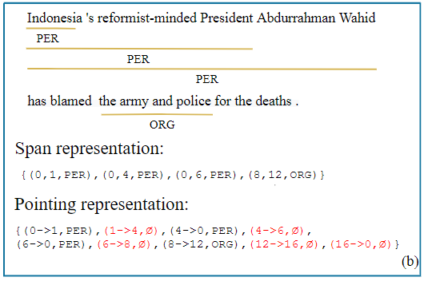
Bottom-Up Constituency Parsing and Nested Named Entity Recognition with Pointer Networks
研究动机
constituency parser：成分句法分析
选区解析和嵌套命名实体识别 (NER) 是相似的任务，因为它们都旨在预测嵌套和非交叉span的集合
基于以下观察：以后序遍历选区树，即在其孩子之后访问父节点，那么两个连续访问的跨度将共享一个边界。我们的模型通过利用指针网络跟踪共享边界并在每一步预测下一个边界。

Slide 25
Bottom-Up Constituency Parsing and Nested Named Entity Recognition with Pointer Networks
研究动机
constituency parser：成分句法分析
选区解析和嵌套命名实体识别 (NER) 是相似的任务，因为它们都旨在预测嵌套和非交叉span的集合
基于以下观察：以后序遍历选区树，即在其孩子之后访问父节点，那么两个连续访问的跨度将共享一个边界。我们的模型通过利用指针网络跟踪共享边界并在每一步预测下一个边界。
在这项工作中，我们将嵌套 NER 转换为选区解析，并提出了一种新的Bottom-Up Constituency Parsing的指向机制来解决这两个任务。

Slide 26
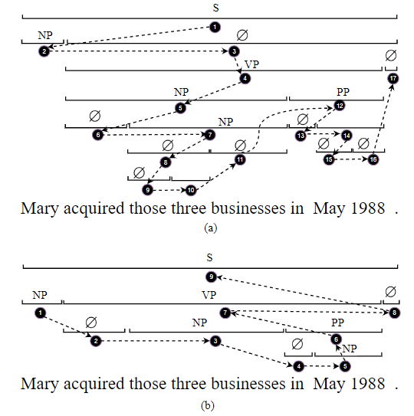
Bottom-Up Constituency Parsing and Nested Named Entity Recognition with Pointer Networks
模型方法
前序
后序

Slide 27
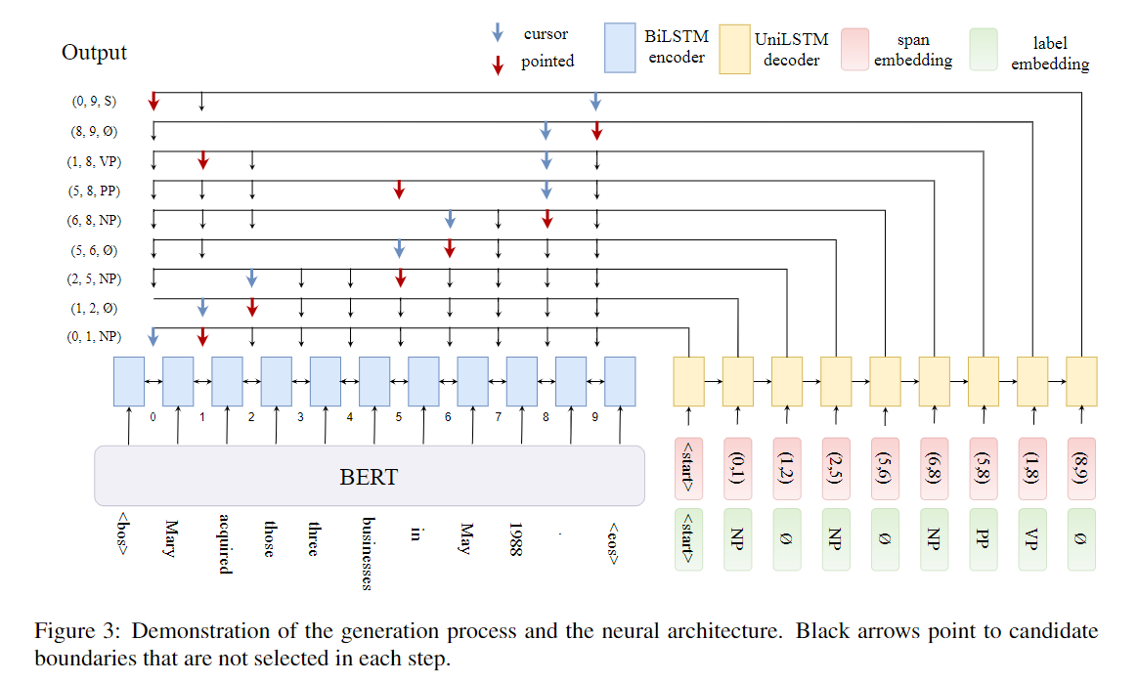
Bottom-Up Constituency Parsing and Nested Named Entity Recognition with Pointer Networks
模型方法
模型通过利用指针网络跟踪共享边界并在每一步预测下一个边界
使用光标跟踪共享边界边界，并在每一步利用指针网络预测下一个边界以生成下一个组成跨度，并将光标更新到新跨度的右边界。

Slide 28
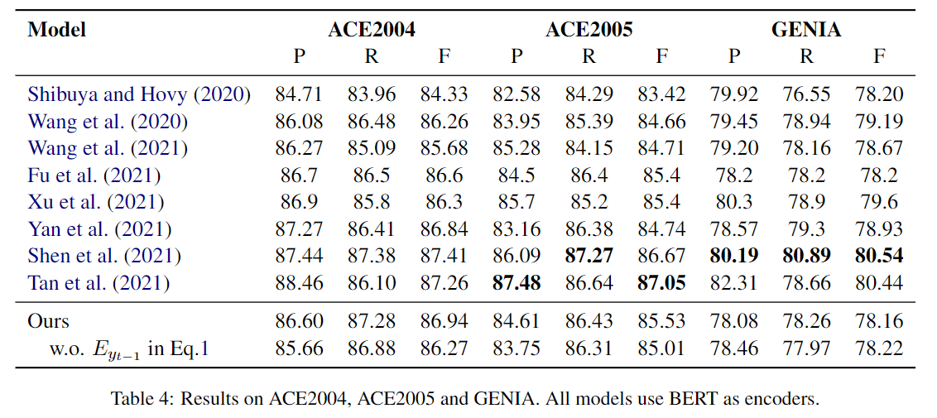
Bottom-Up Constituency Parsing and Nested Named Entity Recognition with Pointer Networks
主要实验
主要是做句法成分解析，顺带做实体，性能并不是很高。

